Slide 1
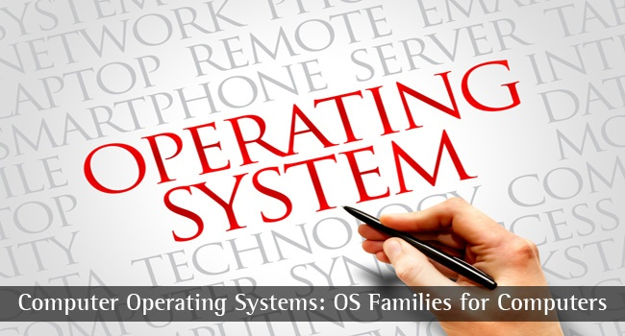
CS-3103 : Operating Systems : Sec-A (NB) : CPU-Scheduling
HIT-BTech-CSEN3103-Operating Systems

Slide 2

Basic Concepts
Maximum CPU utilization obtained with multiprogramming
CPU–I/O Burst Cycle – Process execution consists of a cycle of CPU execution and I/O wait.
CPU burst distribution
HIT-BTech-CSEN3103-Operating Systems

Slide 3

Alternating Sequence of CPU And I/O Bursts
HIT-BTech-CSEN3103-Operating Systems

Slide 4
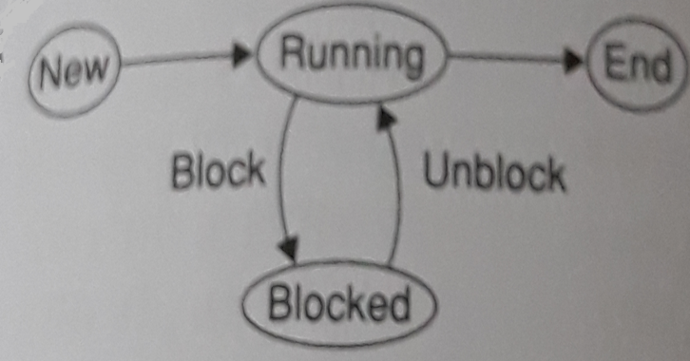
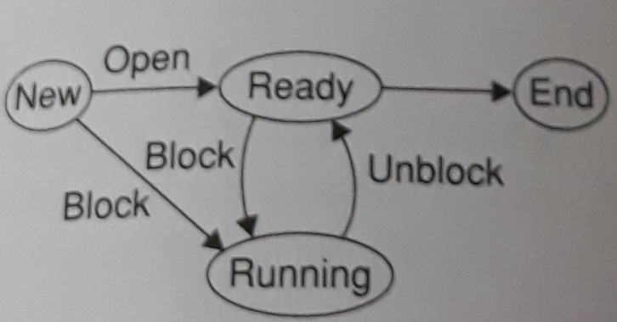
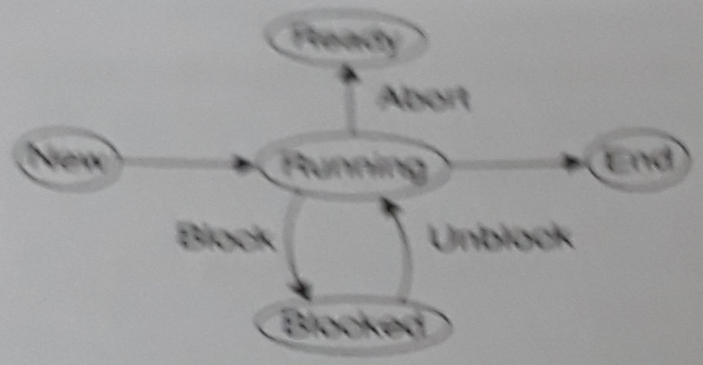
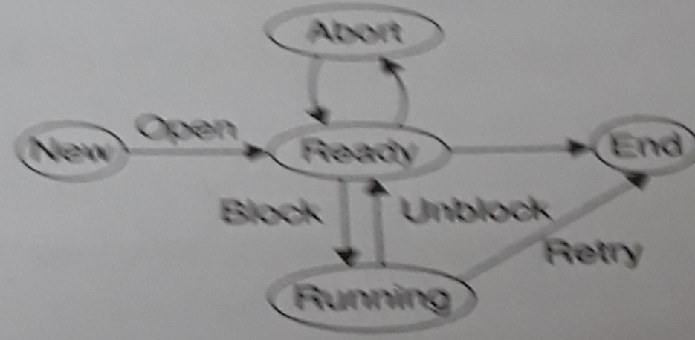
For each of the following transitions, between process states, which transition is not possible?
Running → Ready b) Blocked → Suspend
c) Ready → Ready/Suspend d) Blocked → Running
Ans: (d)
2. Which of the following is an appropriate four-state model for a process?
Ans: (a)
a) |  | b)
c) |  | d)

Slide 5
CPU Scheduler
Selects from among the processes in memory that are ready to execute, and allocates the CPU to one of them.
CPU scheduling decisions may take place when a process:
  1. Switches from running to waiting state.
  2. Switches from running to ready state.
  3. Switches from waiting to ready.
  4. Terminates.
Scheduling under 1 and 4 is non preemptive.
All other scheduling is preemptive.
HIT-BTech-CSEN3103-Operating Systems

Slide 6
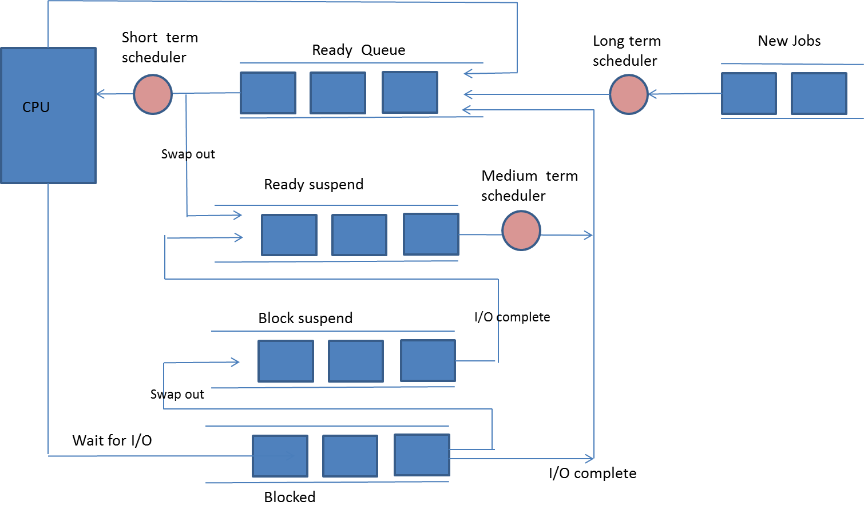
Levels of Scheduling
HIT-BTech-CSEN3103-Operating Systems

Slide 7
Dispatcher [picture in previous slide]
Dispatcher module gives control of the CPU to the process selected by the short-term scheduler; this involves:
  switching context
  switching to user mode
  jumping to the proper location in the user program to restart that program
Dispatch latency – time it takes for the dispatcher to stop one process and start another running.
HIT-BTech-CSEN3103-Operating Systems

Slide 8
Performance Metrics
During the execution of a process, both CPU and process need each other to do any useful work.
The unit of work could be as small as one instruction or as large as one complete process.
This measure is the throughput and is defined as the number of work units completed per unit time.
Throughput is a metric for measuring system performance. Example: the number of application processes completed per second is a measure of the throughput of the system.
HIT-BTech-CSEN3103-Operating Systems

Slide 9
Scheduling Criteria
CPU utilization – keep the CPU as busy as possible
Throughput – # of processes that complete their execution per time unit
Turnaround time – amount of time to execute a particular process. The time between the submission and completion of a job.
Waiting time – amount of time a process has been waiting in the ready queue
Response time – amount of time it takes from when a request was submitted until the first response is produced, not output (for time-sharing environment)
HIT-BTech-CSEN3103-Operating Systems

Slide 10
Optimization Criteria
Max CPU utilization
Max throughput
Min turnaround time
Min waiting time
Min response time
HIT-BTech-CSEN3103-Operating Systems

Slide 11
Process Scheduling Queues
Job queue – set of all processes in the system.
Ready queue – set of all processes residing in main memory, ready and waiting to execute.
Device queues – set of processes waiting for an I/O device.
Process migration is performed between the various queues.
HIT-BTech-CSEN3103-Operating Systems

Slide 12
FCFS Scheduling
Jobs are executed on first come, first serve basis.
Easy to understand and implement.
Poor in performance as average wait time is high.
Exercise: Let P1, P2, P3, P4 and P5 be five processes that have become ready at the same time. They have joined the ready queue in the said order. Suppose they need 10, 6, 20, 2 and 4 units of time, respectively, to complete their executions. We assume that they are purely CPU-bound processes and they do not execute any waiting instructions. In addition, we ignore the context-switching time. The OS executes processes P1, P2, P3, P4 and P5, one after another in the said order.
HIT-BTech-CSEN3103-Operating Systems

Slide 13
FCFS Scheduling (Cont.)
P1 | P2 | P3 | P4 | P5
0 10 | 16 | 36 | 38 | 42
Gantt chart of CPU allocation to processes with their turnaround/response times are 10,16, 36, 38 and 42 time units respectively. Thus, average response time = 28.4 time units.
P4 | P5 | P2 | P1 | P3
0 2 | 6 | 12 | 22 | 42
With a different order, P4<P5<P2<P1<P3, turnaround/response times would be 2,6,12,22 and 42 time units respectively. Thus, average response time = 16.80 time units.
HIT-BTech-CSEN3103-Operating Systems

Slide 14
First-Come, First-Served (FCFS) Scheduling
Example: Process CPU Burst Time
P₁ 24
P₂ 3
P₃ 3
Suppose that the processes arrive in the order: P₁ , P₂ , P₃
The Gantt Chart for the schedule is:
Waiting time for P₁ = 0; P₂ = 24; P₃ = 27
Average waiting time: (0 + 24 + 27)/3 = 17
P₁
P₂
P₃
0
24
27
30
HIT-BTech-CSEN3103-Operating Systems

Slide 15
FCFS Scheduling (Cont.)
Suppose that the processes arrive in the order
P₂ , P₃ , P₁ .
The Gantt chart for the schedule is:
Waiting time for P₁ = 6; P₂ = 0; P₃ = 3
Average waiting time: (6 + 0 + 3)/3 = 3
Much better than previous case.
P₂
P₃
P₁
0
3
6
30
HIT-BTech-CSEN3103-Operating Systems

Slide 16
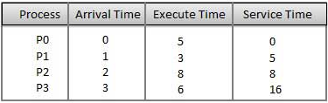
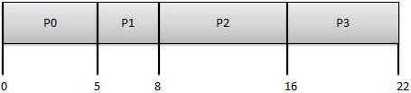
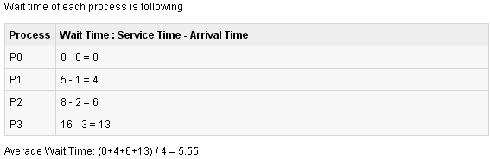
FCFS Scheduling (Cont.)
SERVICE TIME: The time required by a device to handle a request.
HIT-BTech-CSEN3103-Operating Systems

Slide 17
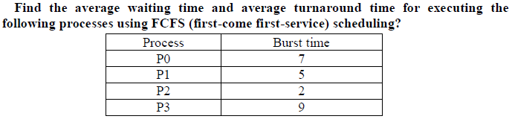
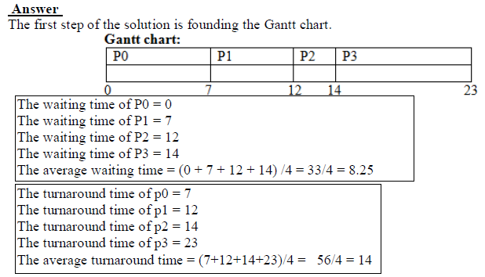
FCFS Scheduling (Cont.)
HIT-BTech-CSEN3103-Operating Systems

Slide 18
Shortest-Job-First (SJF) Scheduling
This algorithm associates with each process the length of the process’s next CPU burst.
When the CPU is available, it is assigned to the process that has the smallest next CPU burst.
If the next CPU bursts of two processes are the same, FCFS scheduling is used to break the tie.
Most appropriate term → shortest-next-CPU-burst algorithm, because scheduling depends on the length of the next CPU burst of a process, rather than its total length.
Best approach to minimize waiting time.
Processer should know in advance how much time process will take.
HIT-BTech-CSEN3103-Operating Systems

Slide 19
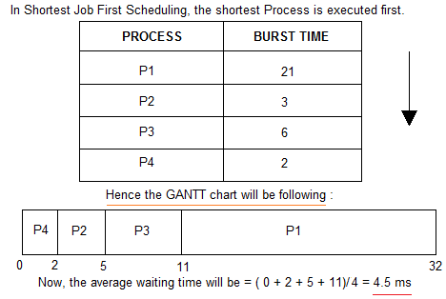
Shortest-Job-First (SJF) Scheduling (Non-preemptive nature)…
Consider the following processes available in the ready queue for execution, with arrival time as 0 for all and the burst times are given.
HIT-BTech-CSEN3103-Operating Systems

Slide 20
Shortest-Job-First (SJF) Scheduling…
Associate with each process the length of its next CPU burst. Use these lengths to schedule the process with the shortest time.
Two schemes:
  Non-preemptive – once CPU given to the process it cannot be preempted until completes its CPU burst.
  Preemptive – if a new process arrives with CPU burst length less than remaining time of current executing process, preempt. This scheme is know as the
  Shortest-Remaining-Time-First (SRTF).
SJF is optimal – gives minimum average waiting time for a given set of processes.
HIT-BTech-CSEN3103-Operating Systems

Slide 21
Example of Non-Preemptive SJF
Process Arrival Time Burst Time
P₁ 0.0 7
P₂ 2.0 4
P₃ 4.0 1
P₄ 5.0 4
SJF (non-preemptive)
Average waiting time = (0 + 6 + 3 + 7)/4 → 4
Non-Preemptive SJF
P₁
P₃
P₂
P₄
0
3
7
8
12
16
Wait Time → P1: 0, P2: 8-2=6, P3: 7-4=3, P4: 12-5=7
HIT-BTech-CSEN3103-Operating Systems

Slide 22
Example of Preemptive SJF
Process Arrival Time Burst Time
P₁ 0.0 7
P₂ 2.0 4
P₃ 4.0 1
P₄ 5.0 4
SJF (preemptive)
Average waiting time = (9 + 1 + 0 +2)/4 → 3
Preemptive SJF
P₁
P₂
P₃
P₂
P₄
P₁
0
2
4
5
7
11
16
Wait Time → P1: 0+(11-2)=9; P2: (2-2)+(5-4)=1; P3: 4-4=0; P4: (7-5)=2;
HIT-BTech-CSEN3103-Operating Systems

Slide 23
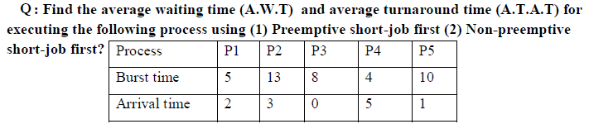
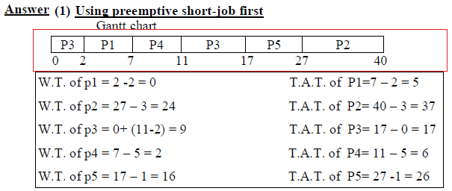
HIT-BTech-CSEN3103-Operating Systems

Slide 24
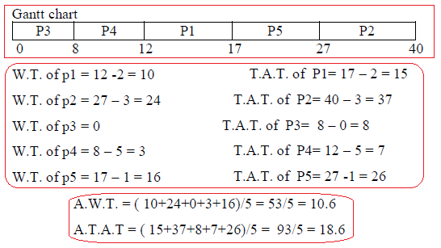
HIT-BTech-CSEN3103-Operating Systems

Slide 25
Priority Scheduling
A priority number (integer) is associated with each process
The CPU is allocated to the process with the highest priority.
Equal-priority processes are scheduled in FCFS order.
An SJF algo. is simply a priority algorithm where the priority (p) is the inverse of the CPU burst value. The larger the CPU burst, the lower the priority, and vice versa.
HIT-BTech-CSEN3103-Operating Systems

Slide 26
Priority Scheduling
The CPU is allocated to the process with the highest priority (smallest integer ≡ highest priority).
  Preemptive
  nonpreemptive
SJF is a priority scheduling where priority is the predicted next CPU burst time.
Problem ≡ Starvation – low priority processes may never execute.
Solution ≡ Aging – as time progresses increase the priority of the process.
HIT-BTech-CSEN3103-Operating Systems

Slide 27
Priority Scheduling (Cont.)
Process | Burst Time | Priority
P1 | 10 | 3
P2 | 1 | 1
P3 | 2 | 4
P4 | 1 | 5
P5 | 5 | 2
P2 | P5 | P1 | P3 | P4
0 1 | 6 | 16 | 18 | 19
Using priority scheduling (Non-preemptive), we would schedule these processes according to the above table and Gantt chart. The average waiting time is 8.2 milliseconds.
Wait Time: P1: 6; P2: 0; P3: 16; P4: 18; P5: 1
HIT-BTech-CSEN3103-Operating Systems

Slide 28
Indefinite blocking (or starvation)
A major problem with priority-scheduling algorithms is indefinite blocking (or starvation).
A process that is ready to run but lacking the CPU can be considered blocked – waiting for the CPU.
A priority-scheduling algorithm can leave some low-priority processes waiting indefinitely for the CPU.
In a heavily loaded computer system, a steady stream of higher-priority processes can prevent a low-priority process from ever getting the CPU.
Bad example: Rumor : When IBM 7094 at MIT was shut down in 1973, they found a low-priority process that had been submitted in 1967 and had not yet been run.
HIT-BTech-CSEN3103-Operating Systems

Slide 29
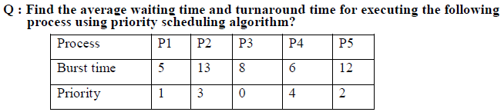
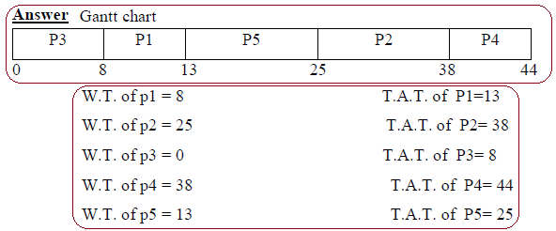

HIT-BTech-CSEN3103-Operating Systems

Slide 30
Round Robin (RR)
Each process gets a small unit of CPU time (time quantum), usually 10-100 milliseconds. After this time has elapsed, the process is preempted and added to the end of the ready queue.
If there are n processes in the ready queue and the time quantum is q, then each process gets 1/n of the CPU time in chunks of at most q time units at once. No process waits more than (n-1)q time units.
Performance
  q large ⇒ FIFO
  q small ⇒ q must be large with respect to context switch, otherwise overhead is too high.
HIT-BTech-CSEN3103-Operating Systems

Slide 31
Example: RR with Time Quantum = 20
Process Burst Time
P₁ 53
P₂ 17
P₃ 68
P₄ 24
The Gantt chart is:
Typically, higher average turnaround than SJF, but better response.
P₁
P₂
P₃
P₄
P₁
P₃
P₄
P₁
P₃
P₃
0
20
37
57
77
97
117
121
134
154
162
HIT-BTech-CSEN3103-Operating Systems

Slide 32
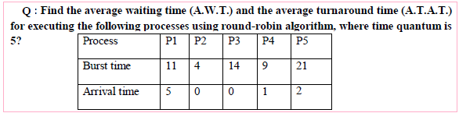
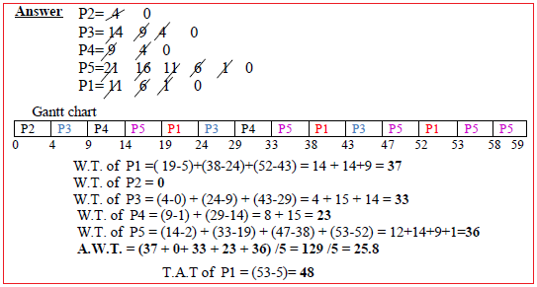
HIT-BTech-CSEN3103-Operating Systems

Slide 33

HIT-BTech-CSEN3103-Operating Systems

Slide 34

How a Smaller Time Quantum Increases Context Switches
HIT-BTech-CSEN3103-Operating Systems

Slide 35
Multilevel Queue
Ready queue is partitioned into separate queues:
foreground (interactive)
background (batch)
Each queue has its own scheduling algorithm,
foreground – RR
background – FCFS
Scheduling must be done between the queues.
  Fixed priority scheduling; i.e., serve all from foreground then from background. Possibility of starvation.
  Time slice – each queue gets a certain amount of CPU time which it can schedule amongst its processes; i.e.,
  80% to foreground in RR
  20% to background in FCFS
HIT-BTech-CSEN3103-Operating Systems

Slide 36
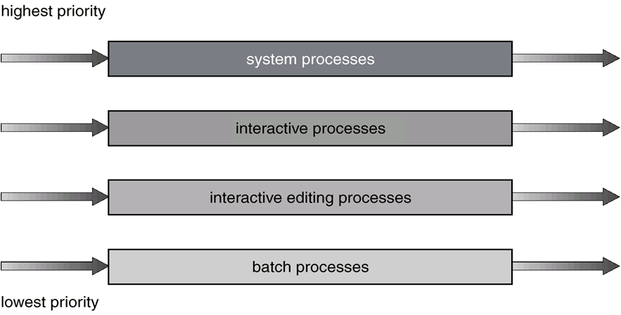
Multilevel Queue Scheduling
HIT-BTech-CSEN3103-Operating Systems

Slide 37
Multilevel Feedback Queue
A process can move between the various queues; aging can be implemented this way.
Multilevel-feedback-queue scheduler defined by the following parameters:
  number of queues
  scheduling algorithms for each queue
  method used to determine when to upgrade a process
  method used to determine when to demote a process
  method used to determine which queue a process will enter when that process needs service
HIT-BTech-CSEN3103-Operating Systems

Slide 38

Multilevel Feedback Queues
HIT-BTech-CSEN3103-Operating Systems

Slide 39
Example of Multilevel Feedback Queue
Three queues:
  Q₀ – time quantum 8 milliseconds
  Q₁ – time quantum 16 milliseconds
  Q₂ – FCFS
Scheduling
  A new job enters queue Q₀ which is served FCFS. When it gains CPU, job receives 8 milliseconds. If it does not finish in 8 milliseconds, job is moved to queue Q₁.
  At Q₁ job is again served FCFS and receives 16 additional milliseconds. If it still does not complete, it is preempted and moved to queue Q₂.
HIT-BTech-CSEN3103-Operating Systems

Slide 40
Multiple-Processor Scheduling
CPU scheduling more complex when multiple CPUs are available.
Homogeneous processors within a multiprocessor.
Load sharing
Asymmetric multiprocessing – only one processor accesses the system data structures, alleviating the need for data sharing.
HIT-BTech-CSEN3103-Operating Systems

Slide 41
Real-Time Scheduling
Hard real-time systems – required to complete a critical task within a guaranteed amount of time.
Soft real-time computing – requires that critical processes receive priority over less fortunate ones.
HIT-BTech-CSEN3103-Operating Systems

Slide 42

Dispatch Latency
HIT-BTech-CSEN3103-Operating Systems

Slide 43
Algorithm Evaluation
Deterministic modeling – takes a particular predetermined workload and defines the performance of each algorithm for that workload.
Queuing models
Implementation
HIT-BTech-CSEN3103-Operating Systems

Slide 44

Evaluation of CPU Schedulers by Simulation
HIT-BTech-CSEN3103-Operating Systems

